Slide 1
Your Travel Copilot
Team-code 9
Recommendation System
Notes:
Here we will introduce Travel Copilot, an intelligent assistant for planning trips, based on the Yelp dataset.

Slide 2
Table of contents
01
03
Introduction
Yelp !
02
04
Model
Future Work
Notes:
This is our content.

Slide 3
—Someone Famous
“Travel is Good
Notes:
So, Travel is Good, But

Slide 4
—Another one Famous
“But not that much good
when you are a
Perfectionism”
Notes:
——But not that much good when you are a Perfectionism.

Slide 5
01
Introduction
Notes:
So, Why

Slide 6
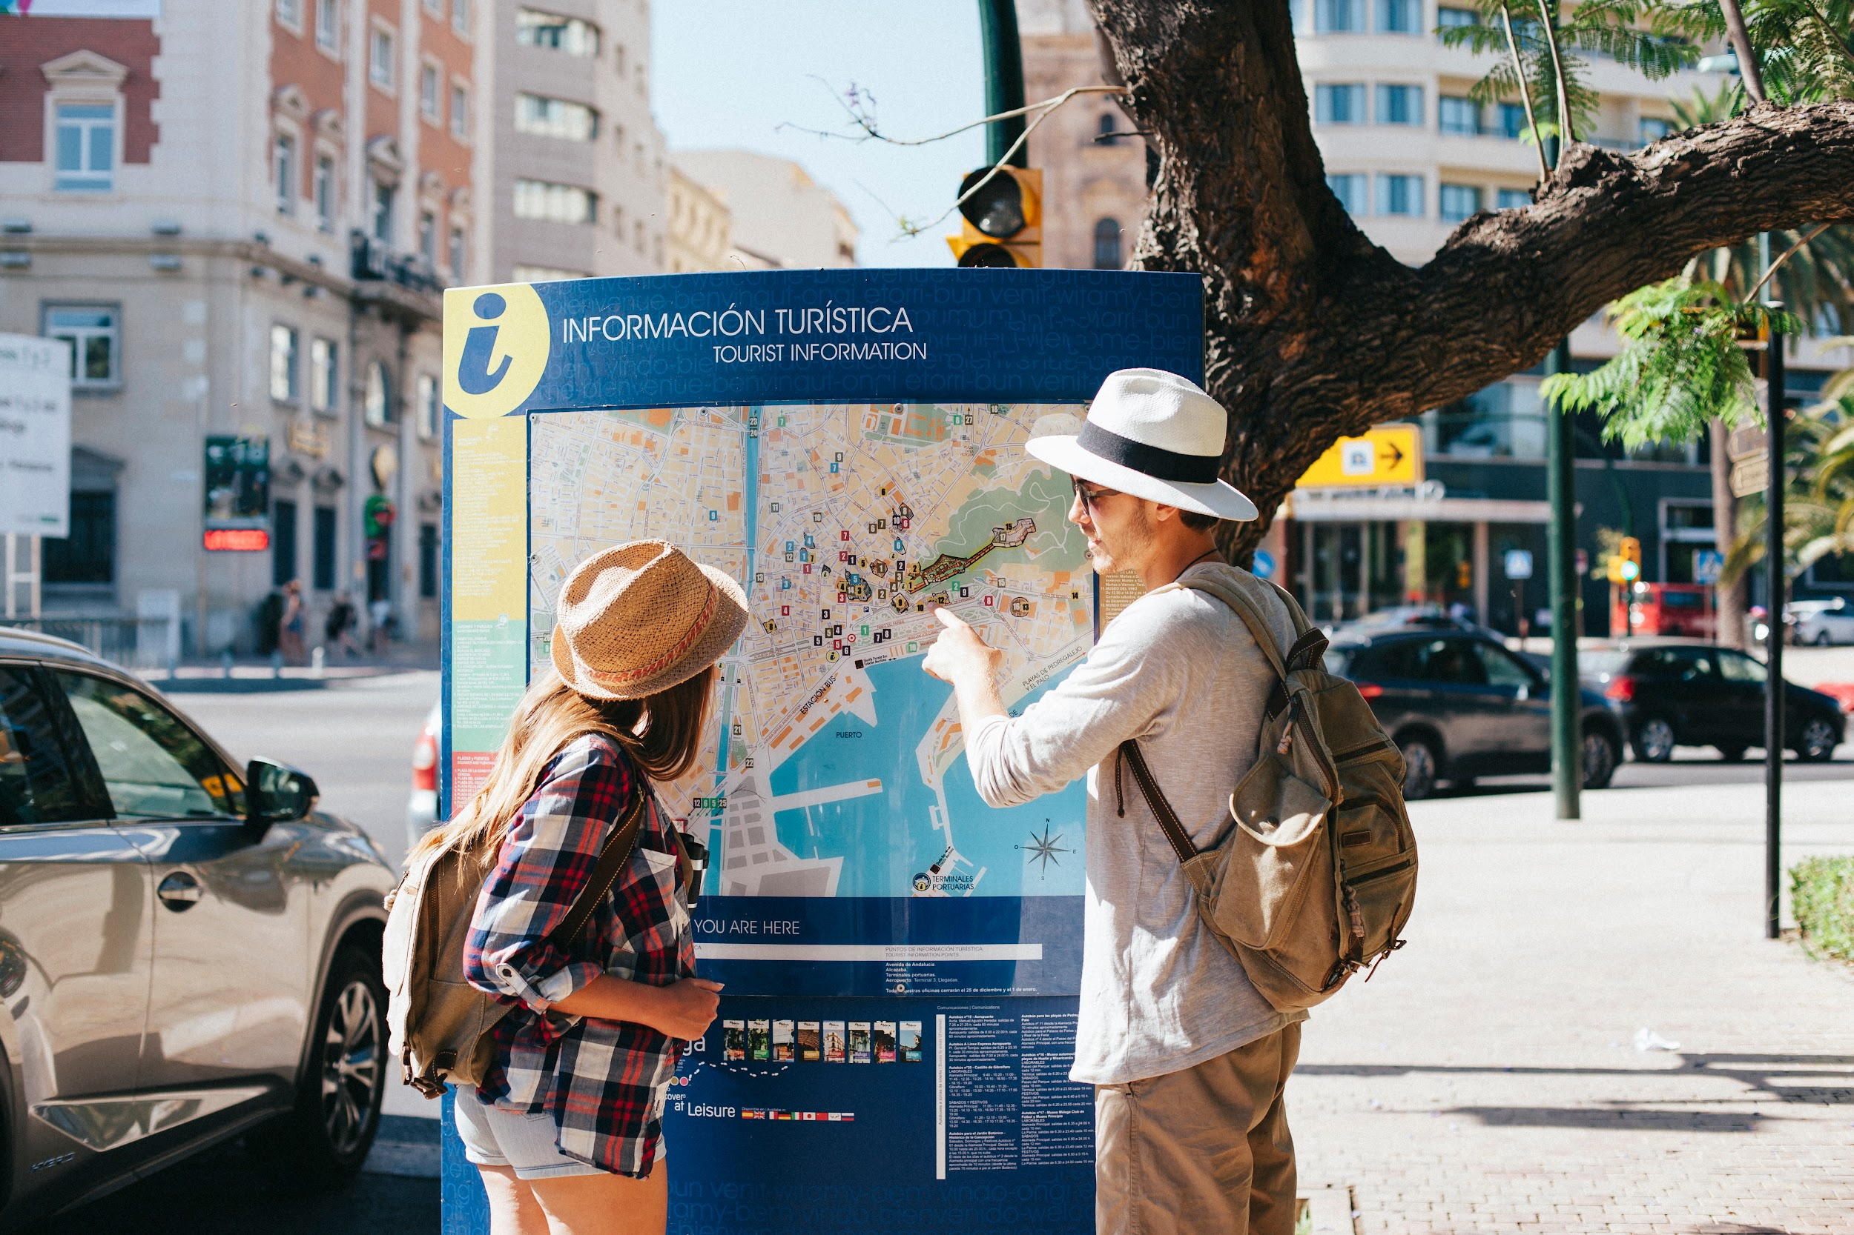
Imagine that …
Imagine that you are a person who:
- has clear preferences
- always pursues the ultimate experience
And now you are planning to travel to a strange city. In order to pursue the best experience, what should be done?
Perhaps, you can browse the evaluations of various attractions, hotels, and restaurants to see the evaluations of their customer
Notes:
Imagine that you are a person who: has clear preferences ,and always pursues the ultimate experience，And planning to travel to a city that you've never been.

Slide 7
Your special preference
Attractions
Restaurants
Hotels
1
3
most coastal,
lively restaurant
Hospitality, beach, child friendly
2
Not only needs to be comfortable, but more importantly – Must be quiet and has parking
Notes:
Lets make it clearer that you want to go to a seaside, kid-friendly beach destination, a quiet hotel, and want to taste coastal food.
May be you can just find the local hotel and restaurant that has the highest ratings.

Slide 8
Everything is so hard
High score but not for you
So many choices and have to consider the distance
Go browse the local restaurant listings by rating, you might find one that isn't necessarily coastal
Even if you have worked hard to find the most suitable attractions, hotels and restaurants, you may be frustrated to find that they are too far apart, so that the time on the road
kills your travel interest
Notes:
But, the problem is, the highest-rated restaurant might be a KFC – not coastal at all, and the highest-rated hotel maybe sea view room, but not quite. And distance is also a problem.

Slide 9
Your Travel Copilot
Notes:
So, introducing, Travel Copilot, to solve your troubles.

Slide 10
What will Travel Copilot do for you?
Full Plan
easy to use
Only for you
Travel essentials
Attractions, hotels, restaurants, and route plan
Full GUI Support and
Chat-GPT Support
Your unique preferences and habits, without missing a single one
Child friendly
Security
Parking Lot
Pet friendly
Notes:
It knows all your special preferences, and consider all your needs (you don’t want to drive to a place without a parking lot), and it also has a GUI.

Slide 11
02
Yelp !
Copilot is based on Yelp Dataset
Notes:
Travel Copilot is based on Yelp Acadamic dataset

Slide 12
What does Yelp Dataset include?
Businesses
Users
Reviews
Restaurants, hotels, attractions and their star ratings
Users and their friends, comments, check-ins
Users give business their reviews
Notes:
Which contains businesses, users, and reviews. Let’s dig into it.

Slide 13
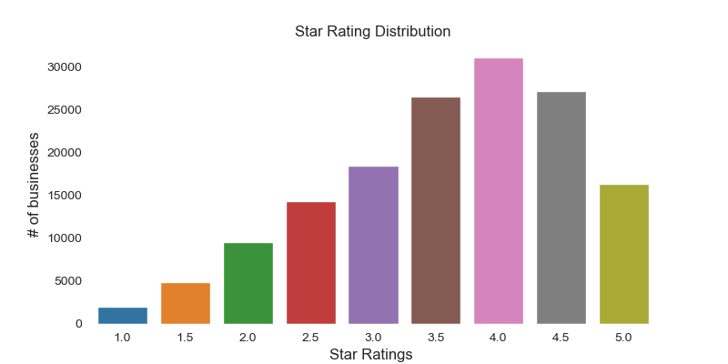
Business Ratings
Notes:
Each business has its own rating.

Slide 14
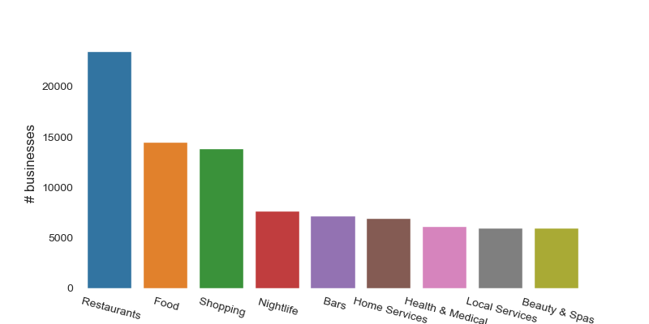
Business Categories
Notes:
You can find a variety of businesses here, but the most common ones are restaurants.

Slide 15
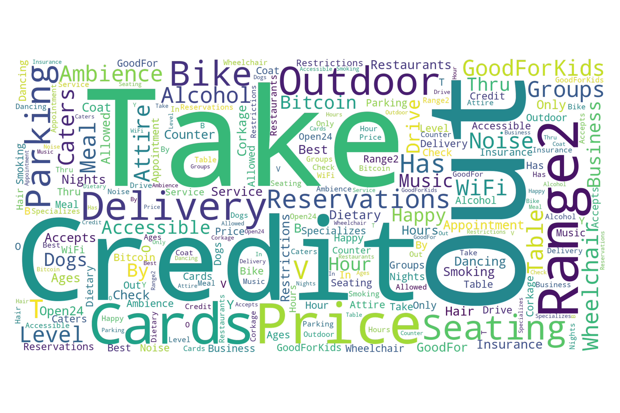
Restaurants Business Attributes
Notes:
We use Worcloud to illustrate the complex feature of the business. For restaurant, we can set whether there are alcoholic drinks (like, you don’t want it if you have a child with you) and whether it has parking lot, and so on.

Slide 16
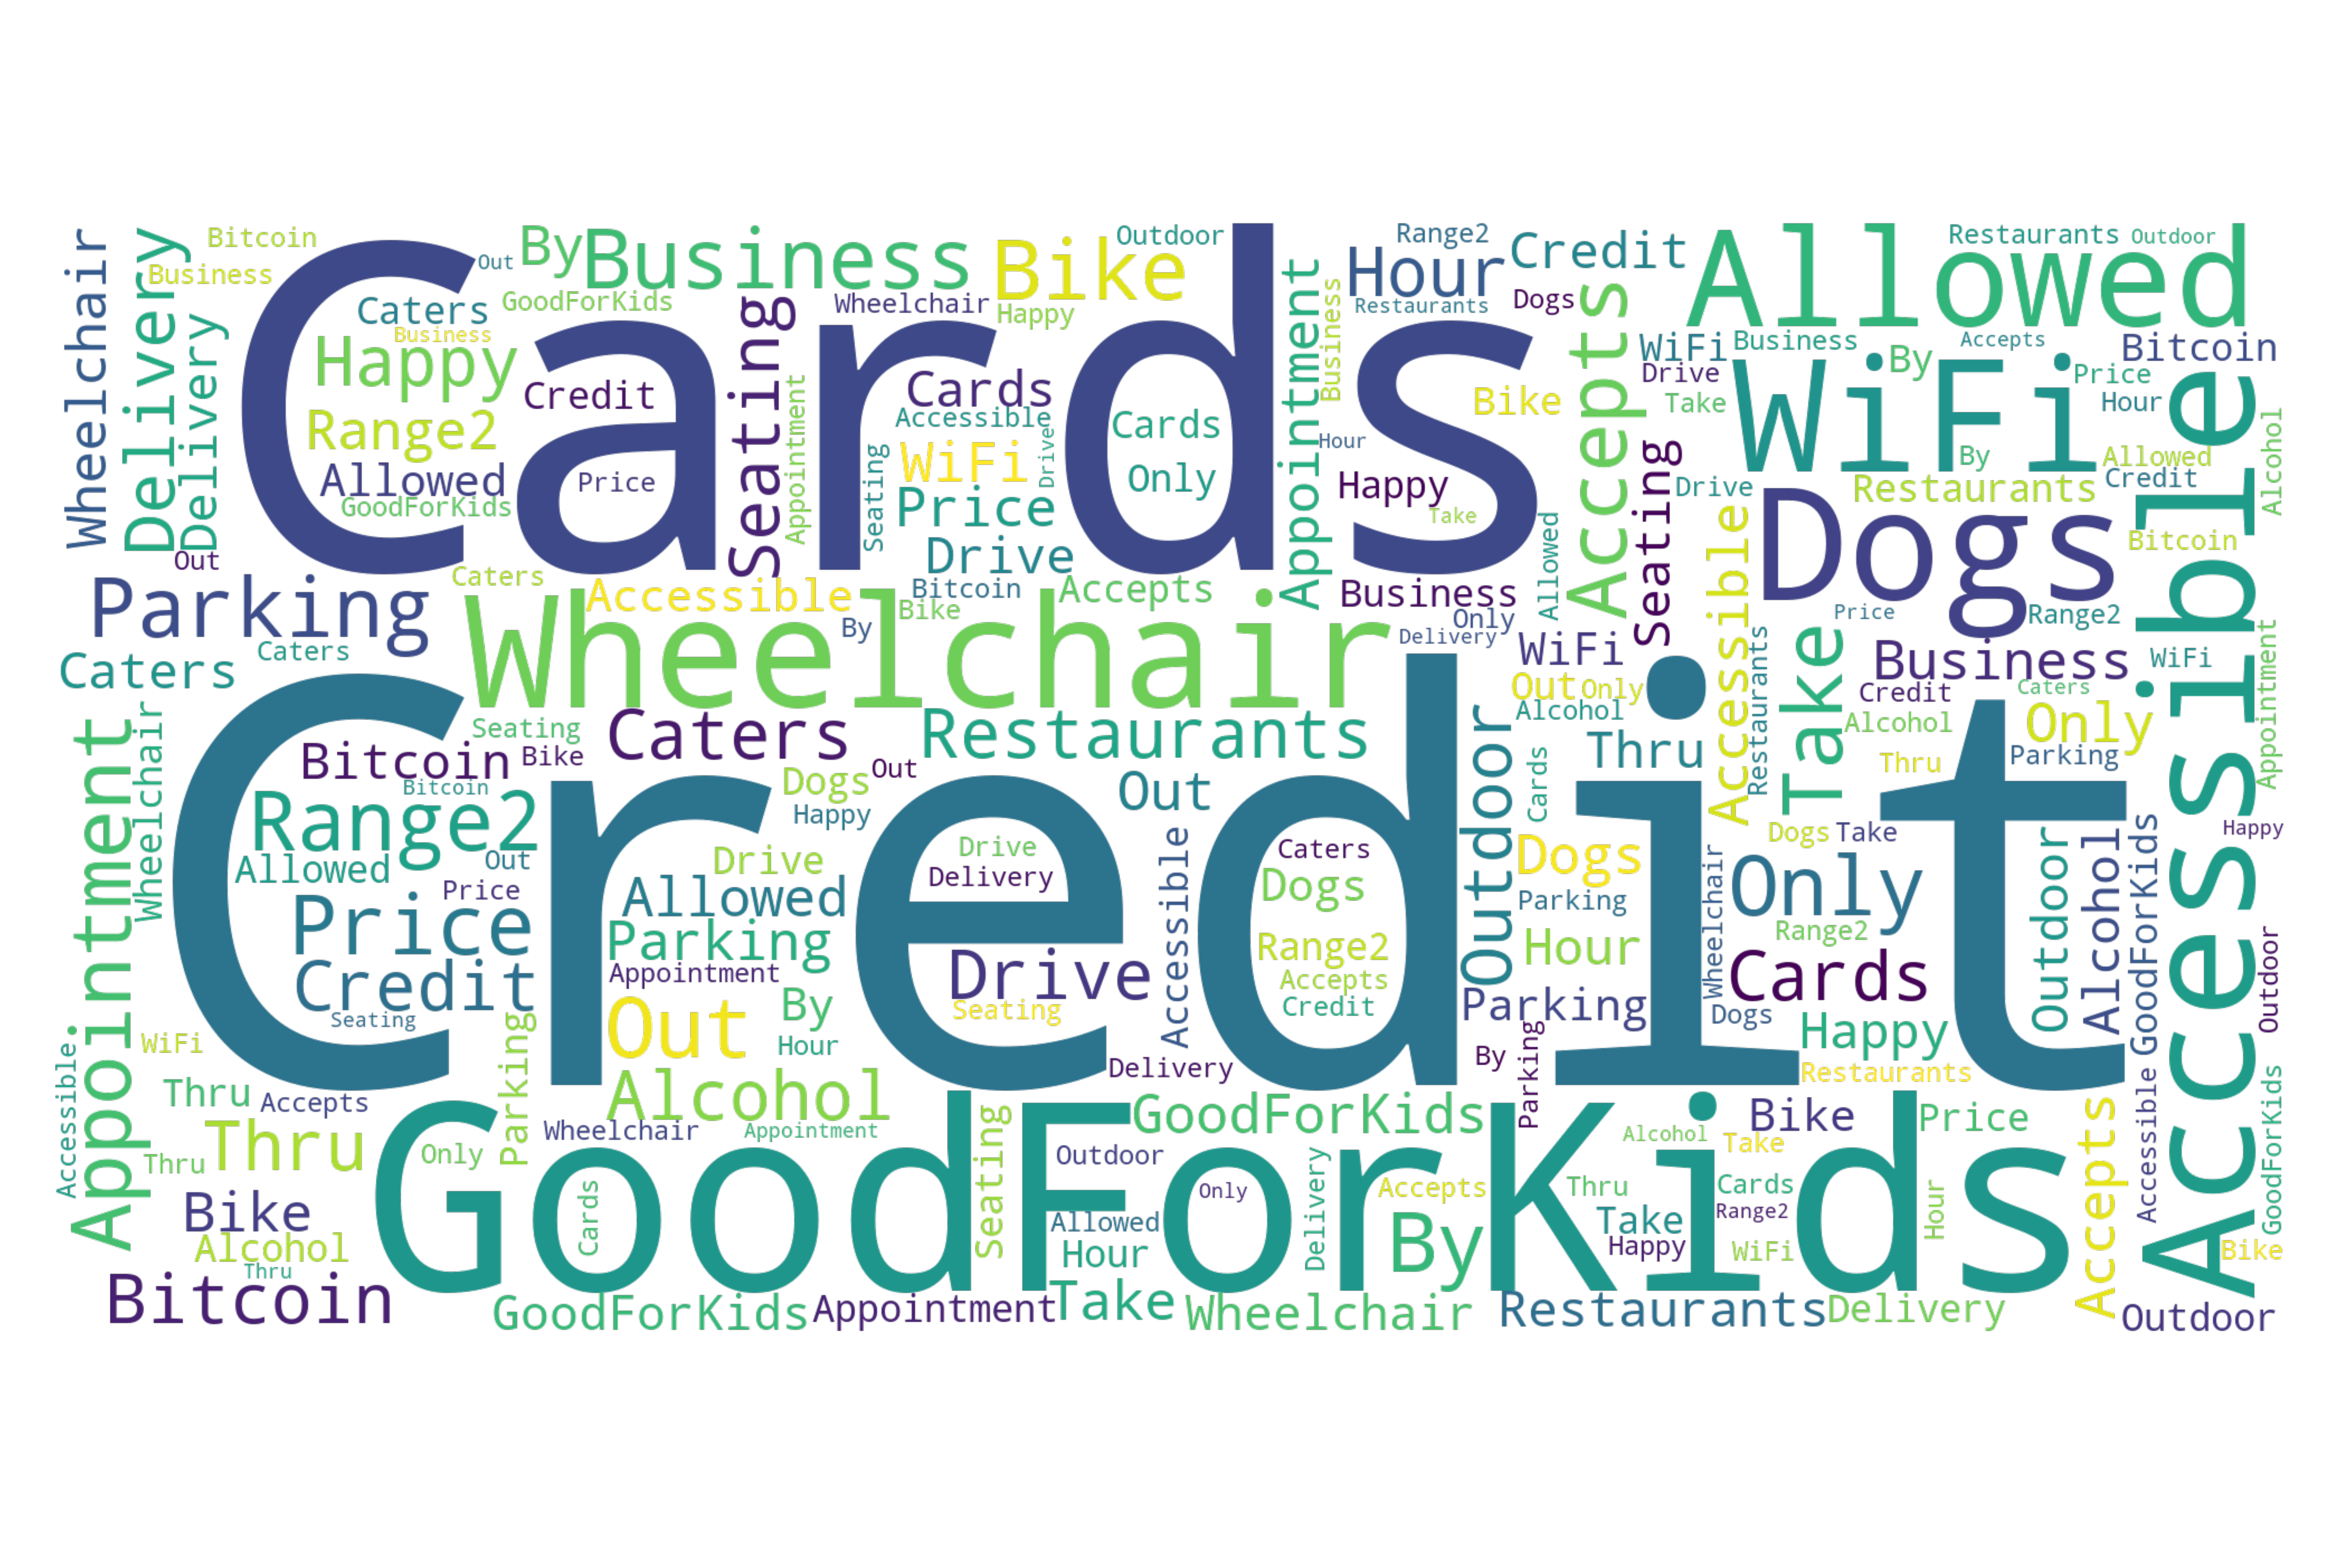
Attractions Business Attributes

Slide 17
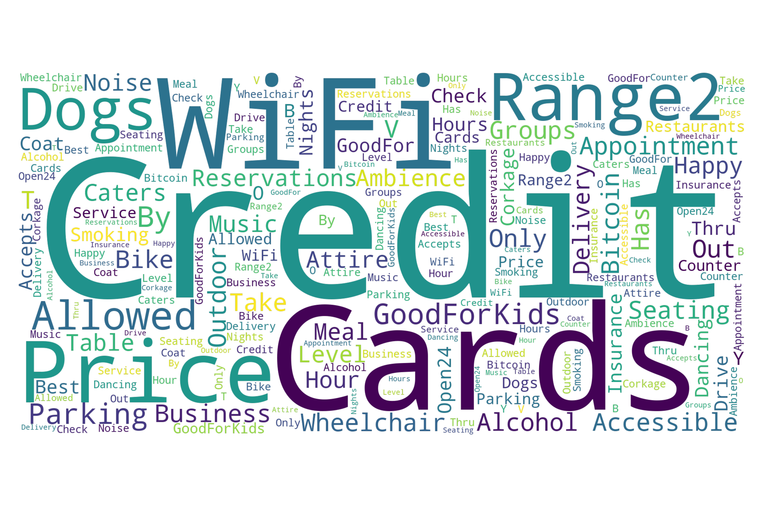
Hotels Business Attributes

Slide 18
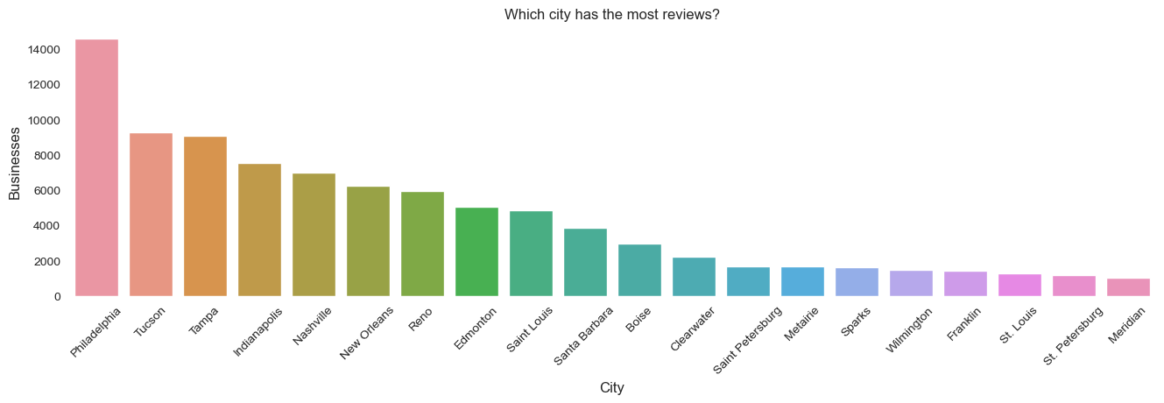
Which city has the most reviews?
Notes:
Also,we can find out that Philadelphia has the most reviews.

Slide 19

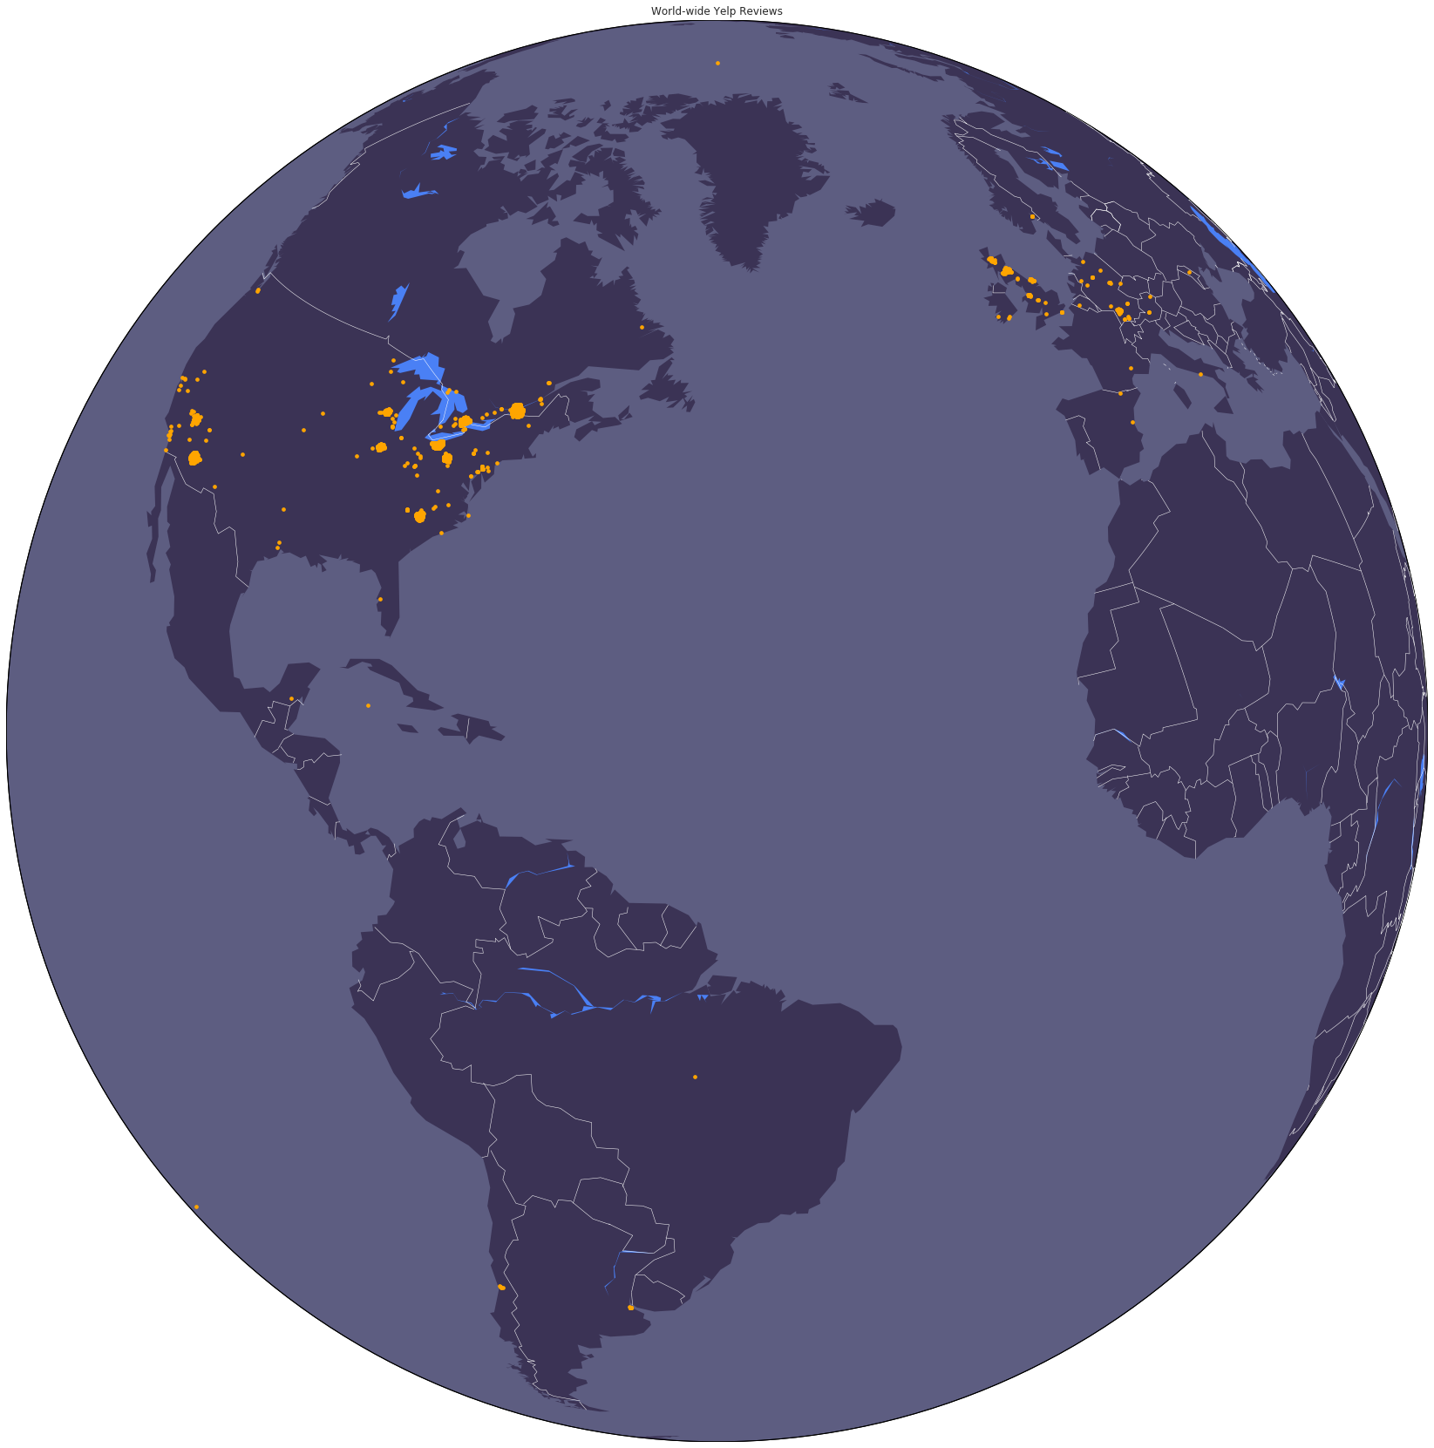
Reviews Distribution
Notes:
And the reviews are mainly in Europe and the US spatially.

Slide 20
Reviews Dataset Examples
Bob give this restaurant 3.0/5.0 stars.
Alice give this restaurant 5.0/5.0. She loves it.
“Wow! Yummy, different, delicious. Our favorite is the lamb curry and korma. With 10 different kinds of naan!!! Don't let the outside deter you (because we almost changed our minds)...go in a...”
“If you decide to eat here, just be aware it is going to take about 2 hours from beginning to end. We have tried it multiple times, because I want to like it! I have been to it's other locations in...”
Notes:
More specifically, the reviews in the dataset look like this, you can have positive and negative reviews.

Slide 21
Data Preprocessing
01
Text Filtering
Select only categories related to attractions/restaurants/hotel industry
02
Data Cleaning
Only keep data with reviews
Remove data marked as closed
03
Index Maintenance
Assign a continuous row ID for
businesses and reviews dataset
Create an edge between a user and a restaurant if the user has good reviews for the restaurant
04
Bipartite Graph Construction
Notes:
To prepare our data for analysis, we use several techniques. First, we apply text filtering by selecting only relevant： categories attractions, restaurants, and hotels. Next, we clean the data by removing closed businesses and keeping only reviews. We also perform index maintenance by assigning a continuous row ID to both the businesses and reviews for better organization. Finally, we construct a bipartite graph by connecting users to restaurants based on their positive reviews, allowing for further analysis.

Slide 22
03
Model

Slide 23
Recommendation System
Attractions
Hotels
Restaurants
Matrix Factorization (SVD) Recommender
Matrix Factorization (Funk-SVD) Recommender
LightGCN Recommender System

Slide 24
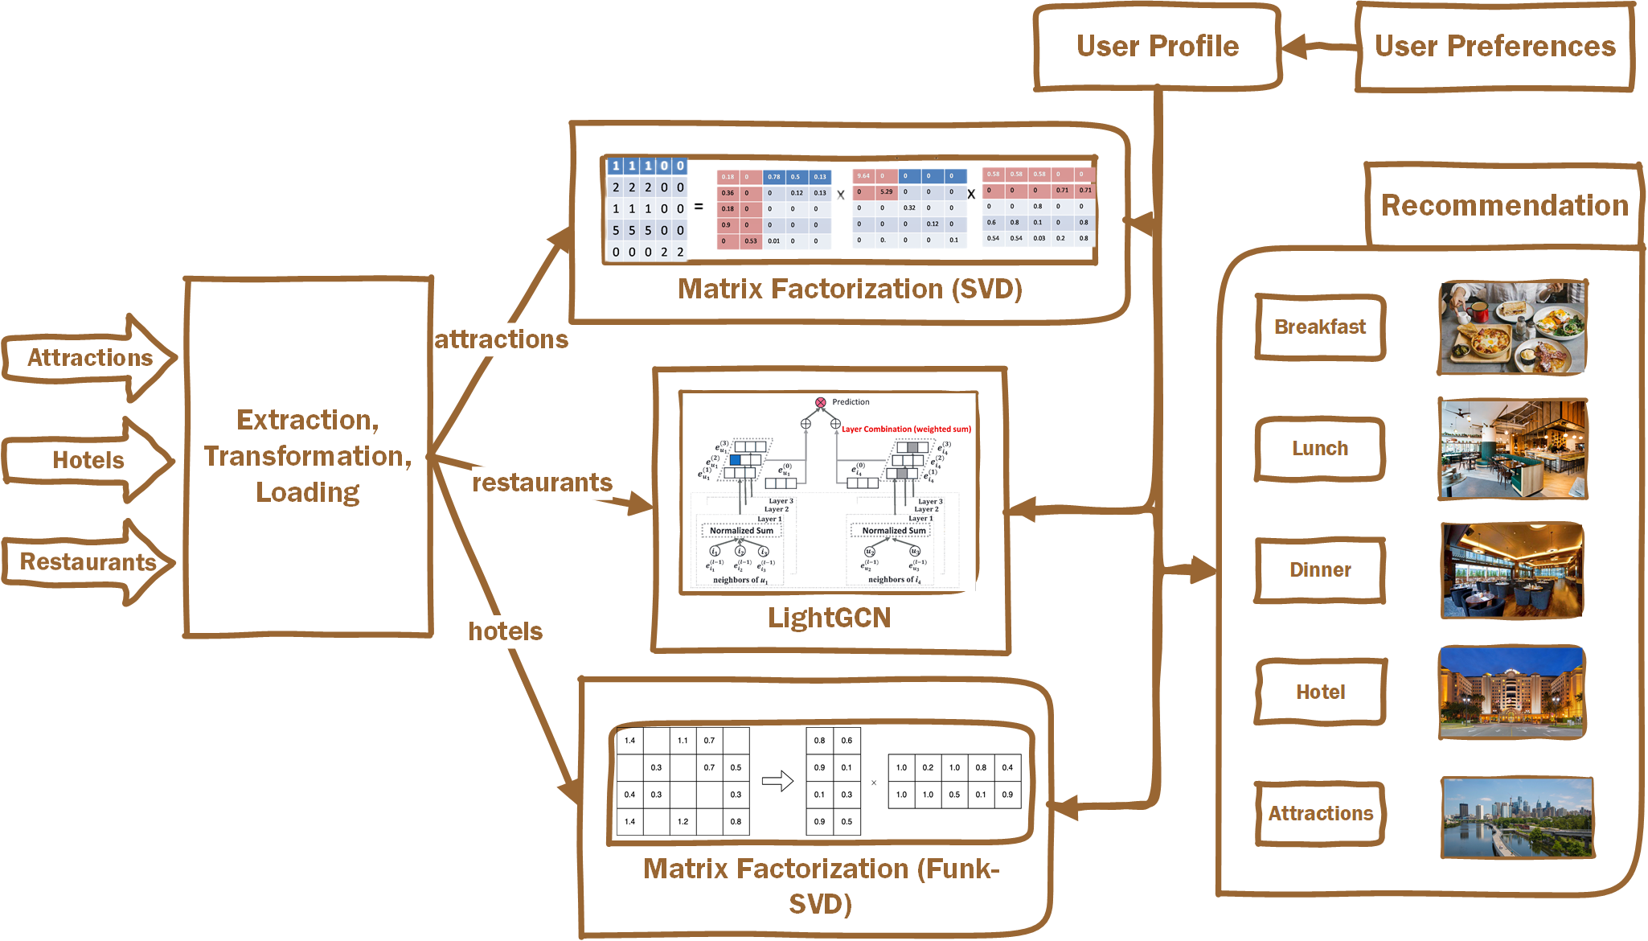
Model Structure
Notes:
Here is a block diagram of our model. After we have preprocessed the data, we select algorithms that can provide recommendations based on the characteristics of hotels, restaurants, and attractions in the Yelp dataset. We then use this information to generate target travel plans that are tailored to the user's past preferences and inclinations for this trip.

Slide 25
Hotels Recommendation System
Attractions, Hotels
Funk-SVD
Matrix Factorization
SVD
Notes:
好的，我可以用一个类比来帮助你理解矩阵分解推荐系统。
假设你想要买一本书，但是你不知道哪本书适合你。你可以去图书馆，看看每本书的标签，比如类型，作者，出版年份等。这些标签就是书的特征，可以帮助你筛选出你可能感兴趣的书。但是这些标签可能不够全面，也不能反映出书的质量和风格。
另一种方法是，你可以看看其他人对每本书的评分，比如1到5星。这些评分就是用户-物品评分矩阵，可以反映出用户和物品之间的偏好关系。但是这个矩阵可能很稀疏，也就是说很多人没有给很多书评分，所以你不能直接根据评分来选择书。
那么，矩阵分解推荐系统就是一种解决方案。它的思想是，每个用户和每本书都有一些隐含的特征，比如用户的兴趣爱好，书的主题风格等。这些隐含特征可以用一个低维的向量来表示，比如2维或3维。这样，用户和物品就可以用一个点来表示在一个空间中的位置。如果两个点之间的距离越近，就说明他们之间的相似度越高。如果一个用户和一本书之间的距离越近，就说明这个用户对这本书的评分越高。
那么，如何得到这些隐含特征向量呢？这就是矩阵分解要做的事情。它要把用户-物品评分矩阵分解为两个矩阵，一个是用户-特征矩阵，一个是特征-物品矩阵。这两个矩阵相乘就可以还原出原始的评分矩阵。同时，它们也可以用来预测缺失的评分，也就是说，如果一个用户没有给一本书评分，我们可以用他的特征向量和这本书的特征向量相乘得到一个预测评分。然后我们就可以根据预测评分来给用户推荐他可能喜欢的书。
这就是矩阵分解推荐系统的基本原理。当然，在实际应用中，还有很多细节和技巧需要考虑，比如如何选择合适的特征维度，如何优化分解过程，如何处理噪声和异常值等。

Slide 26
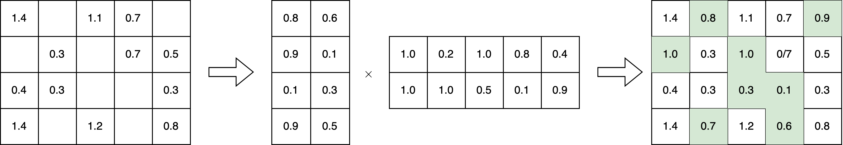
Matrix Factorization Recommender System
SVD
Funk-SVD
Notes:
When planning a trip, choosing the right hotel can be daunting. We can filter out options based on their characteristics, but this method may not reflect the quality and uniqueness of the hotel. Alternatively, we can use a user-item rating matrix, but it may be sparse, and we cannot rely solely on ratings to choose hotels.
Matrix factorization solves this problem by using each user's and hotel's implicit characteristics, represented by a low-dimensional vector. Users and items can be represented by a point in space, and the closer the distance between two points, the higher the similarity. Matrix factorization decomposes the rating matrix into two matrices, one for user features and one for hotel features. Multiplying these matrices restores the original matrix and predicts missing ratings. We can use these predicted ratings to recommend hotels that the user may enjoy staying at.

Slide 27
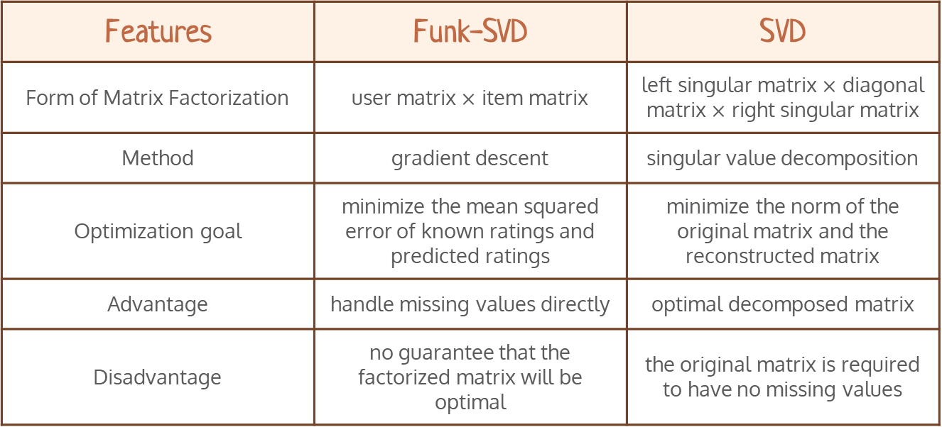
SVD vs. Funk-SVD
Features | Funk-SVD | SVD
Form of Matrix Factorization | user matrix $×$ item matrix | left singular matrix $×$ diagonal matrix $×$ right singular matrix
Method | gradient descent | singular value decomposition
Optimization goal | minimize the mean squared error of known ratings and predicted ratings | minimize the norm of the original matrix and the reconstructed matrix
Advantage | handle missing values directly | optimal decomposed matrix
Disadvantage | no guarantee that the factorized matrix will be optimal | the original matrix is required to have no missing values
Notes:
Now that we have discussed the approach for hotel recommendations, let's talk about the attraction recommendations. As I mentioned earlier, the attraction dataset is relatively clean and has a lower level of sparsity. Therefore, we opted for SVD over Funk-SVD, as it is faster and more accurate. The concept of SVD is similar to Funk-SVD, so I won't go into too much detail here. However, I would like to highlight the main difference between the two.
The primary difference is in the form of matrix factorization. As you can see, the Form of Matrix Factorization in SVD is left singular matrix × diagonal matrix × right singular matrix, whereas Funk-SVD has a slightly different factorization.

Slide 28
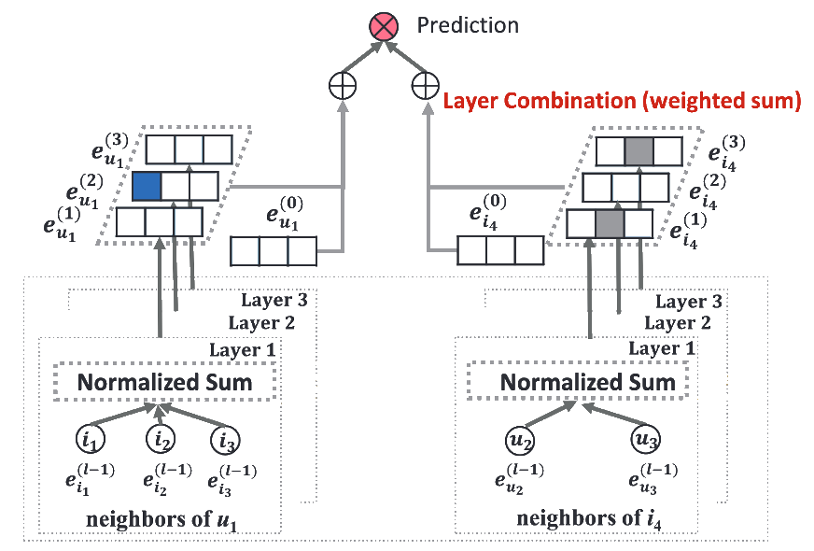
Restaurants Recommendation System - LightGCN
1. Randomly generate some vectors as initial features.
2. Obtain some information from adjacent nodes in each iteration and update it.
3. Perform weighted summation of the vectors obtained through iteration to obtain the final features.
4. Use the final vector to calculate the similarity between any two nodes, and recommend it to the user based on the similarity.
Notes:
To better capture the non-linear relationships between users and restaurants, we utilized a graph convolutional neural network called LightGCN to recommend restaurants to users. GCN uses a user-item graph structure to learn embedding representations that capture high-dimensional features and collaborative filtering signals. Meanwhile, LightGCN removes the complex matrix transformations and non-linear process for using LightGCN for recommendations is as follows:
1. Randomly generate some vectors as initial features.
2. Obtain some information from adjacent nodes in each iteration and update it.
3. Perform weighted summation of the vectors obtained through iteration to obtain the final features.
4. Use the final vector to calculate the similarity between any two nodes, and recommend it to the user based on the similarity.

Slide 29
Traveling Plan Generatiom
Create interactive web pages with PyWebIO
Output the image by bing_image_downloader
01
Attractions
user's preference for categories of attractions
e.g. museums, historical tours, architectural tours
Hotels
02
user's preference for the hotel environment, the distance from the attractions
Restaurants
03
user's preferences for cuisine, restaurant environment, price, special needs (such as vegetarian)
Notes:
Filter recommendation results according to the following elements

Slide 30
Why we Choose this model?
Matrix Factorization
Latent Features Extraction
Relatively Small data
Comprehensiveness
Good Performance
Incorporates additional information flexibly
Finds latent features from ratings
Handles missing values and cold start
Outperforms nearest neighbor techniques

Slide 31
Why we Choose this model?
Light GCN
Efficiency
Conciseness
Effectiveness
High Performance
Removes unnecessary feature transformation and activation
Removes unnecessary feature transformation and activation
Captures high-order collaborative signal so well
Outperforms state-of-the-art GCN model

Slide 32
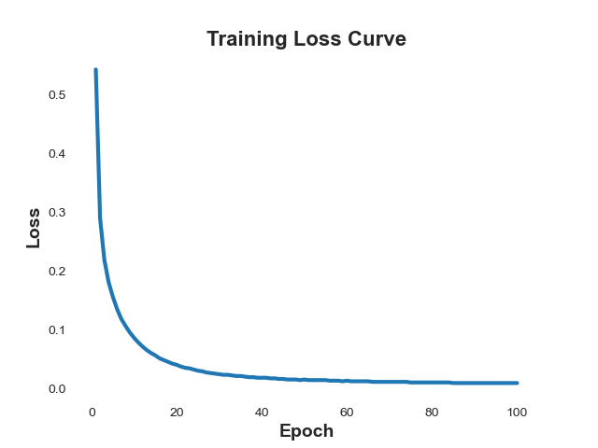
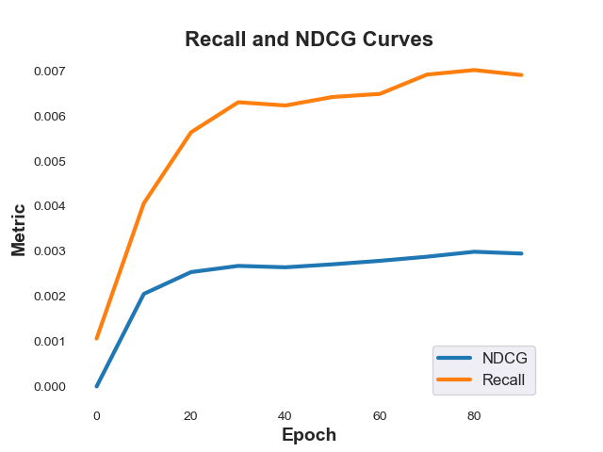
Results
Notes:
Our neural network is amazing. It not only proves it by nice precision data, but also impresses us with its human-like judgment. It can recommend businesses that perfectly suit the users’ preferences, based on their check-in records and review records. It’s like it knows where you want to go as your own.

Slide 33
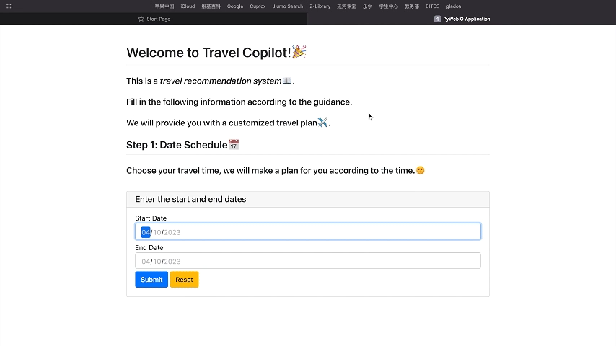
Notes:
The following shows the actual workflow of our Travel Copilot.
First, the user inputs the number of days they plan to travel, and we arrange trip plans based on it.
Then, we ask the user to fill in personal information and the target city for personalized recommendations and filtering.
Next, we ask the user to select the type of attractions they are interested in, with a wide range of tags available for selection. based on the user's selections and previous interests, we recommend three attractions for the user to choose from
Then, based on the user's chosen attractions, we recommend nearby hotels and provide some hotel facility standards for the user to choose from The system recommends three hotels and marks the distances from the attractions
After that, we recommend restaurants for the user. First, we select a breakfast restaurant near the hotel, and the system continues to provide more detailed categories for us to choose from, such as cuisine type and price range near the restaurant. The system continues to recommend until the user has selected three restaurants.
Finally, we have selected one attraction, one hotel, and three restaurants as the plan for a one-day trip.
This is the overall usage process of our Travel Copilot. If you choose a longer date, the system will continue to recommend more travel plans.

Slide 34
04
Future

Slide 35
Travel Copilot
Future Trends:
More Personalized,
More Humane,
More Data,
More Intelligent
Our Prospect:
Communicate with people like ChatGPT
All-round co-pilot assistant in travel
Notes:
So far, we have completed a simple and effective travel recommendation system, mining useful information from huge data sets, and realizing personalized travel planning.
In the future, travel recommendations will be More Personalized, More Humane, and More Intelligent.
We hope to further improve Travel Copilot, so that it can recommend and customize travel plans for users in communication like ChatGPT, and become our All-round co-pilot assistant in travel.

